Slide 1
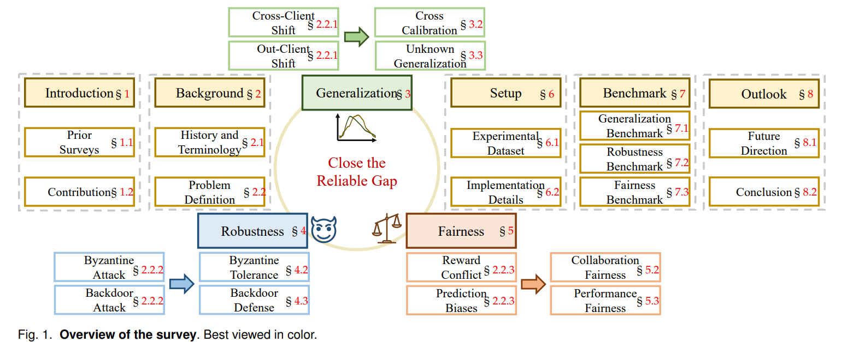
Huang, Wenke, et al. "Federated Learning for Generalization, Robustness, Fairness: A Survey and Benchmark." arXiv preprint arXiv:2311.06750 (2023).

Slide 2
Domain Adaption for Federated Learning
Adversarial Training
Domain Classifier
Domain Generation
Collaboration Training
wolpe
Differential complexity between domains
Label differences
Hyperparameter sensitivity
Understanding domain agnosticism
OOD (Out-of-Distribution )
Zero-Shot and Few-shot
Open-vocabulary Detection
Multi-modal
Wolpert application

Slide 3
Offline Reinforcement Learning
Data heterogeneity
Non-stationary Environment
Explore hard
Lack of real-time feedback
Privacy risk
Data efficiency
Sample Reuse
Explore and exploit trade-off
Safe and stationary
Combine With Federated Learning
Deploy on Model-free
Combine Diffusion or Transformer

Slide 4
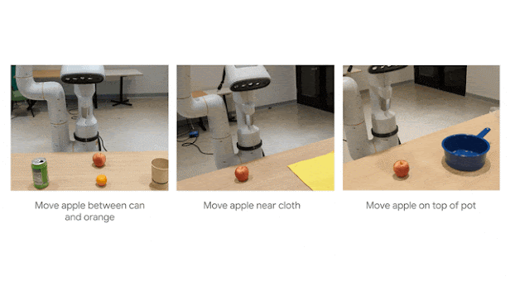
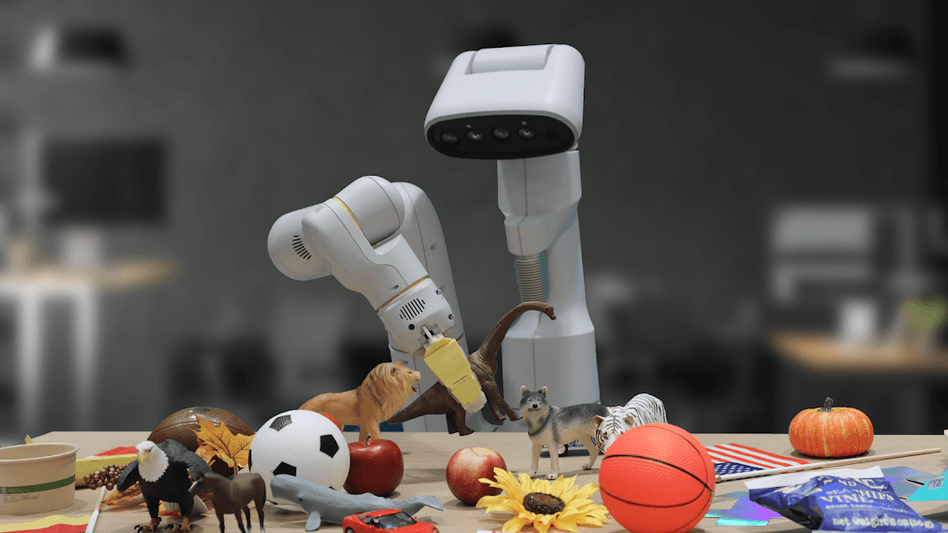
Embodied Intelligence
Deepmind
Kelin Li

Slide 5
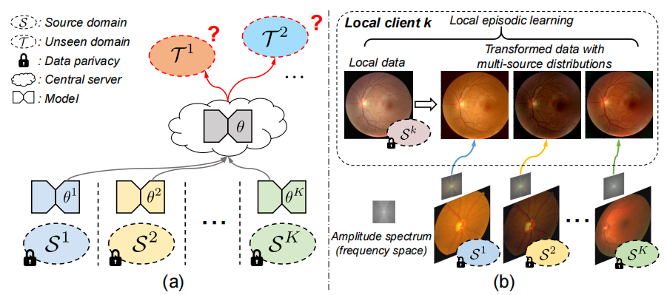
Federated learning
[1] Liu, Quande, et al. "Feddg: Federated domain generalization on medical image segmentation via episodic learning in continuous frequency space." Proceedings of the IEEE/CVF Conference on Computer Vision and Pattern Recognition (CVPR). 2021.

Slide 6
Federated learning
Application: medical image segmentation
Motivation:
Unseen Domain
Privacy and efficiency Trade-off
To enable each client to access multi-source data distributions in a privacy-protecting way
Method:
Continuous frequency space interpolation mechanism (combined with meta learning)
boundary-oriented episodic learning scheme
[1] Liu, Quande, et al. "Feddg: Federated domain generalization on medical image segmentation via episodic learning in continuous frequency space." Proceedings of the IEEE/CVF Conference on Computer Vision and Pattern Recognition (CVPR). 2021.

Slide 7
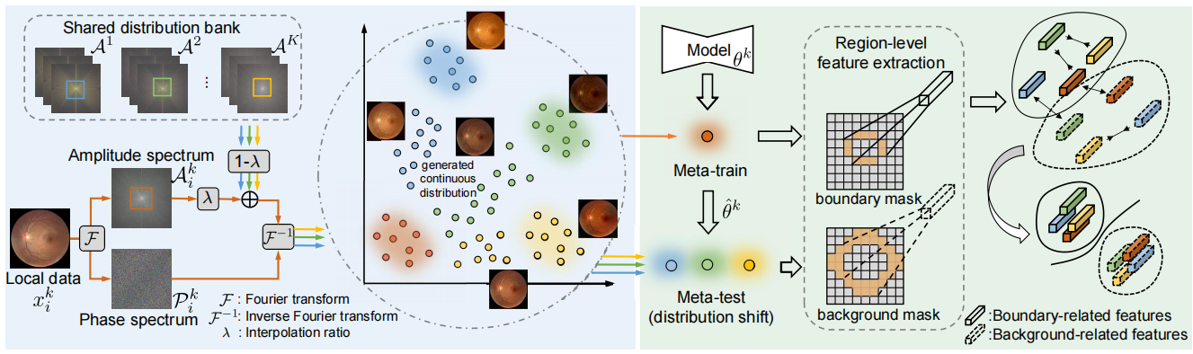
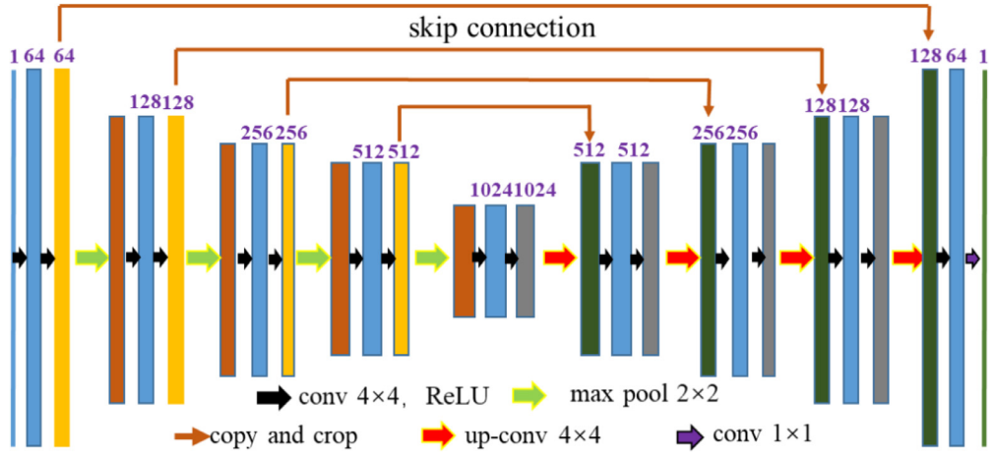
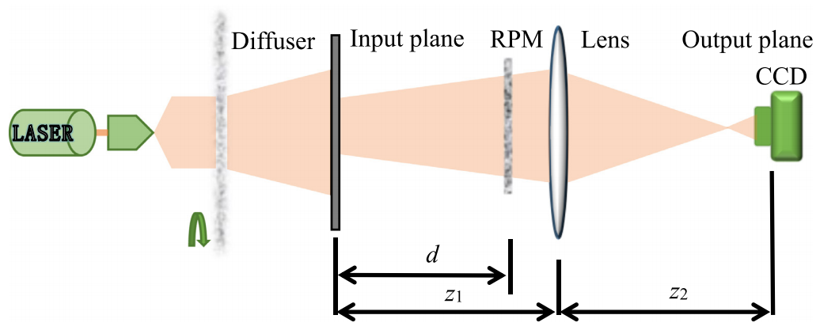
Federated learning
Privacy
Not really?
Sharing amplitude information
(without phase information )
To enable each client to access multi-source data distributions
Achieved!
[2] Wu, Huazheng, et al. "Ciphertext-only attack on optical cryptosystem with spatially incoherent illumination based deep-learning correlography." Optics and Lasers in Engineering 138 (2021): 106454.

Slide 8
Federated learning
Summary :
Highlights:
First work for domain generalization (main contribution)
Novel methods
Generalizability
Drawbacks:
Not a typical federated learning
Parameters’ transferring
Non iid
Not privacy efficiency
[1] Liu, Quande, et al. "Feddg: Federated domain generalization on medical image segmentation via episodic learning in continuous frequency space." Proceedings of the IEEE/CVF Conference on Computer Vision and Pattern Recognition (CVPR). 2021.

Slide 9
Embodied Intelligence
Summary :
Highlights:
First work for domain generalization (main contribution)
Novel methods
Generalizability
Drawbacks:
Not a typical federated learning
Parameters’ transferring
Non iid
Not privacy efficiency
[1] Liu, Quande, et al. "Feddg: Federated domain generalization on medical image segmentation via episodic learning in continuous frequency space." Proceedings of the IEEE/CVF Conference on Computer Vision and Pattern Recognition (CVPR). 2021.

